Slide 1
WHONET Training Course
Module 3 – Data entry
Division of Infectious Diseases, Brigham and Women’s Hospital, Boston, United States
WHO Collaborating Centre for Surveillance of Antimicrobial Resistance

Slide 2
3
Module 3. Data entry
There are two common ways to enter data into WHONET.
Manual data entry
You can manually enter data from paper records into WHONET, either with the desktop application or a new web application.
Importing data with BacLink
If you already have a computer system for managing your microbiology results, you can usually use BacLink to import your existing data. This avoids the need for double data entry.
The data could be from a laboratory information system, a laboratory instrument (Microscan, Phoenix, Vitek, etc.), or other spreadsheet or database software (Excel, Access, etc.).
BacLink will be covered in a separate training course.

Slide 3
3
Module 3. Data entry
A
Create a new data file
B
Entering and editing data
C
Opening an existing data file
D
Clinical reports
E
Importing data with BacLink

Slide 4
3
Select your laboratory from the list
A

Slide 5
3
Click on "Data entry" and "New data file".
A

Slide 6
Name and location of the new data file
3
A
Choose the file folder, for example C:\WHONET\Data
Choose the file name, for example, WHO-TST-2023.sqlite
You can save the data on:
- local hard drive
- network server
- cloud folder.

Slide 7
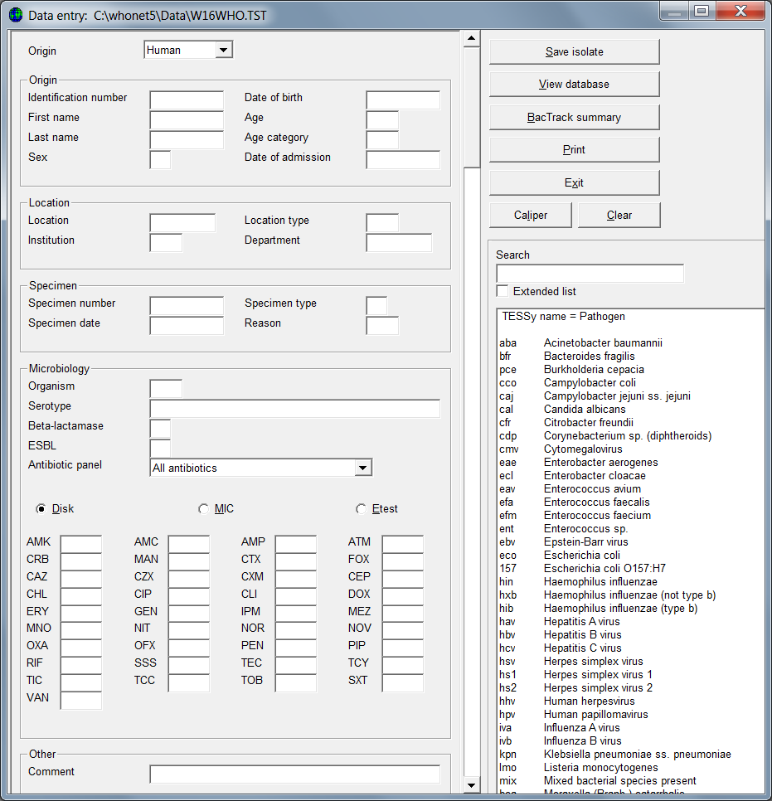
3
Data entry form
A

Slide 8
3
Module 3. Data entry
A
Create a new data file
B
Entering and editing data
C
Opening an existing data file
D
Clinical reports
E
Importing data with BacLink

Slide 9
3
Data entry form
A
Sample origin
Human, animal, food, environment
Location
Specimen
Organism
Antibiotics
Other

Slide 10
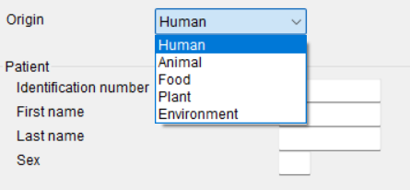
3
Select the origin of the sample
B

Slide 11
3
Origin of the specimen
Human
B
Animal
Food
Environment

Slide 12
3
Location of specimen collection
Human
B
Animal
Food
Environment

Slide 13
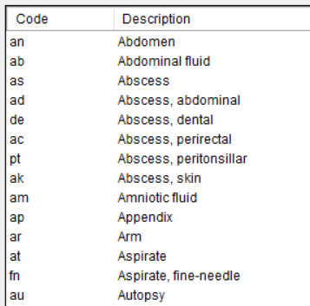
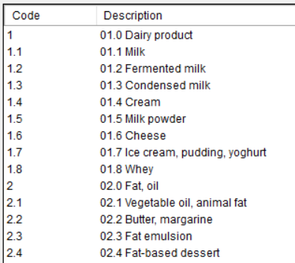
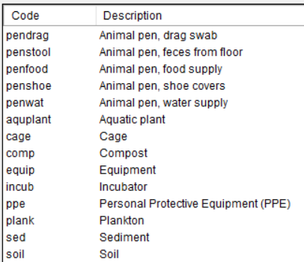
3
Specimen details
All sectors
B
Sample types
Human and animal*
Food
Environment
*Some differences (egg, cloaca…)

Slide 14
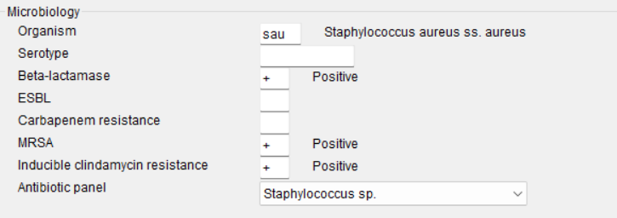
3
Organism results
All sectors
B

Slide 15
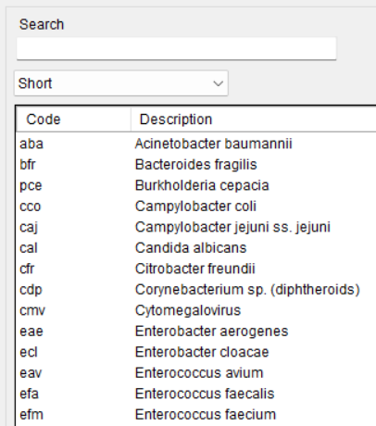
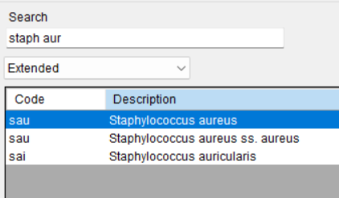
3
Using the search box
B

Slide 16
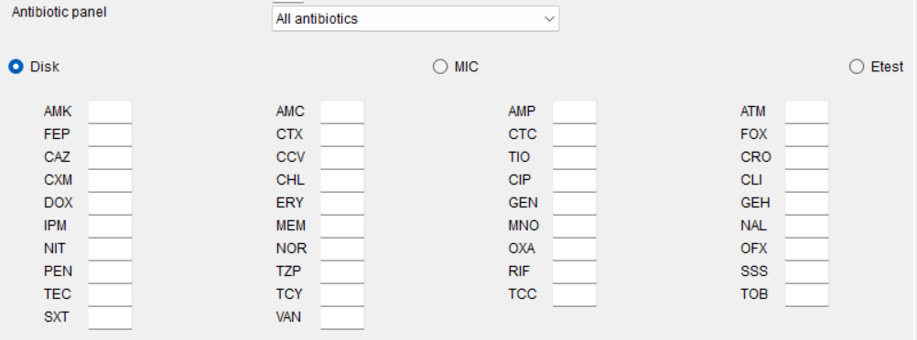
3
Antibiotics and antibiotic panels
B

Slide 17
3
Antibiotic test results
You can either enter test measurements or test interpretations. We recommend the entry of test measurements.
B
Zone diameters
Interpretations

Slide 18
3
Entering MIC and Etest data
Enter MIC data as shown below.
B
For cefotaxime and penicillin, you see multiple interpretations. This is explained further on the next slide.
If you are entering data for trimethoprim/sulfamethoxazole, just enter the MIC value for trimethoprim. For example, if the MIC is 1 μg/ml trimethoprim + 19 μg/ml sulfamethoxazole, just enter “1”.

Slide 19
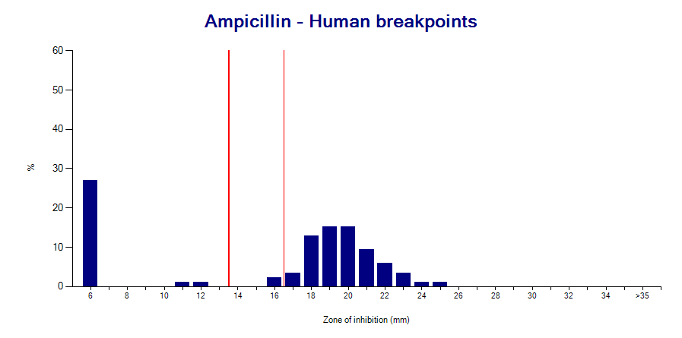
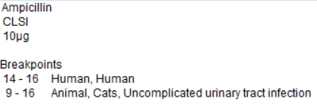
3
The value of test measurements
Required for accurate reporting to clinicians
Interpretive criteria can change over time
Measurements permit an assessment of test quality
Measurements facilitate recognition of microbial subpopulations
Measurements are needed when there are multiple interpretations
Meningitis, Non-meningitis, Urinary tract infection
Human, Dog, Hose, Fish, Epidemiological Cutoff Values
B
Escherichia coli
Escherichia coli
Streptococcus pneumoniae

Slide 20
3
Test interpretations
The most common interpretations are R, I, and S.
R = Resistant
I = Intermediate (CLSI )
I = Susceptible with increased exposure (EUCAST)
S = Susceptible
B
You may also see some additional interpretations.
NS = Nonsusceptible (CLSI). There is a “Susceptible” category, but no “Resistant” category. This category is often used when there is little clinical data to be evaluated by CLSI.
? = There are no breakpoints for this organism and antibiotic
S? and R? are explained on the next slide. Only for off-scale MIC values.

Slide 21
3
S? and R?
These categories only appear for “off-scale” MIC data such as MIC≤1 and MIC>4 when the MIC value does not correspond to the breakpoint. For example, if the breakpoints are S≤1 and R≥4, and a user enters MIC≤2, then there is ambiguity. The “≤” symbol would suggest that the organism is susceptible. However, an MIC of 2 would be intermediate.
This may happen because of a typing mistake by the user. But more commonly the reason is because of a change in the breakpoints. For example, for Escherichia coli, older MIC panels were designed for an imipenem susceptible breakpoint of S≤4. But in 2010, CLSI changed the susceptible breakpoint to S≤1.
WHONET will give the interpretation of “S?” with the idea that most bacteria that were previously considered “S” by the older breakpoints would probably also be susceptible with the new breakpoints if they could be tested.
B

Slide 22
3
Microbiology alerts
WHONET offers microbiology alerts for findings of clinical and public health importance:
Important species
Important resistance
Quality
Therapy
The alerts can help to notify laboratory staff about important findings or results that may suggest an error in the organism identification or the antimicrobial susceptibility test results.
You can also define your own alerts in Laboratory configuration.
B

Slide 23
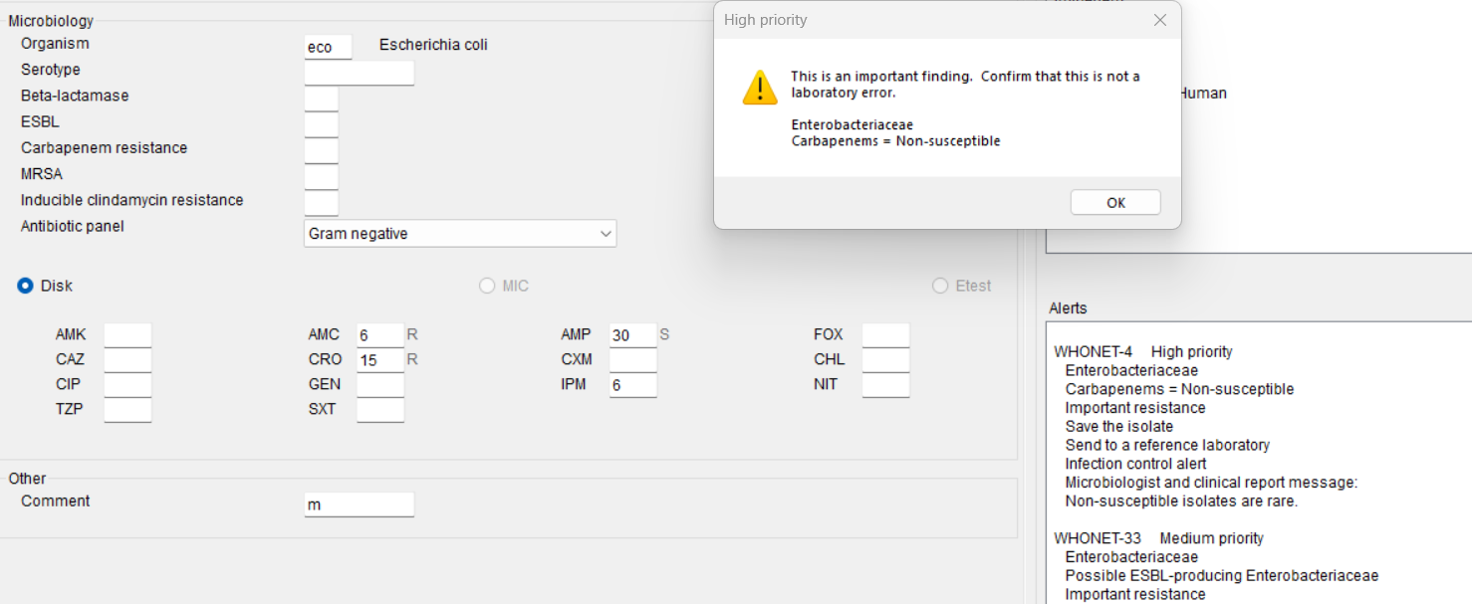
3
Microbiology alert example
The below isolate of Escherichia coli generates alerts for resistance to imipenem (high priority) and ceftriaxone (medium priority). There is also a quality alert because the E. coli is susceptible to ampicillin but resistant to amoxicillin/clavulanic acid.
B

Slide 24
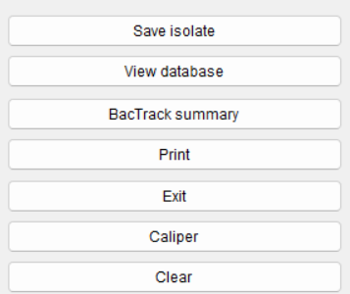
3
Additional options
In this module, we will discuss the three items indicated below.
B

Slide 25
3
Save the isolate
This isolate has no microbiology alerts
B
Human
Animal

Slide 26
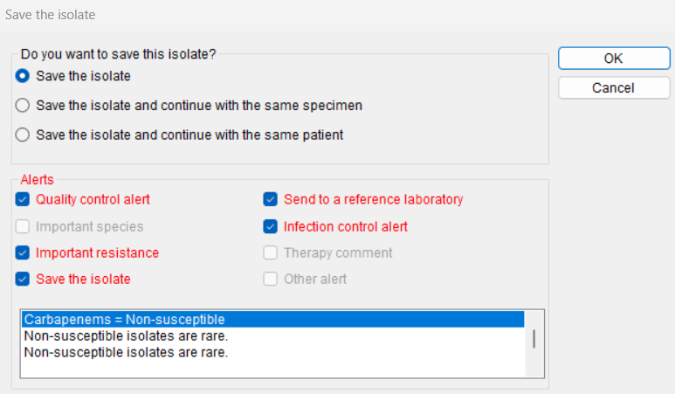
3
Save the isolate
This isolate has several microbiology alerts
Imipenem resistance
Ceftriaxone resistance – Possible ESBL producer
Quality alert - Ampicillin susceptible and Amox/Clav resistant
B

Slide 27
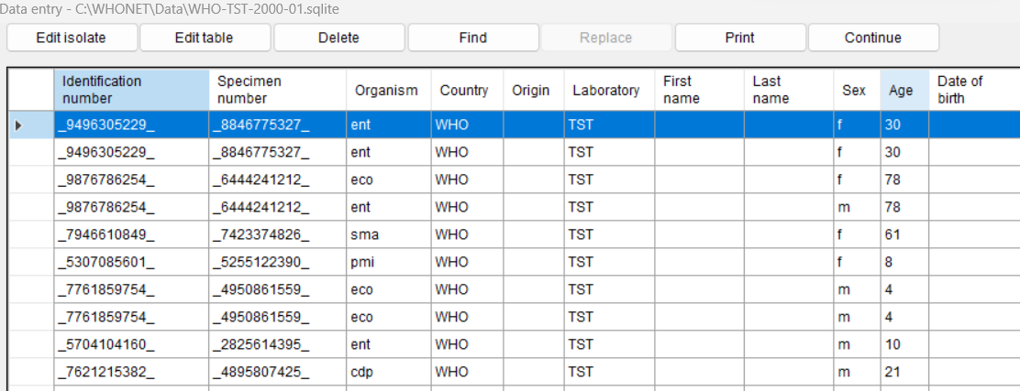
View and modify the database
3
Use this screen to make changes to the database, search for records, or print out clinical reports. When you finish, click on Continue.
B

Slide 28
3
Module 3. Data entry
A
Create a new data file
B
Entering and editing data
C
Opening an existing data file
D
Clinical reports
E
Importing data with BacLink

Slide 29
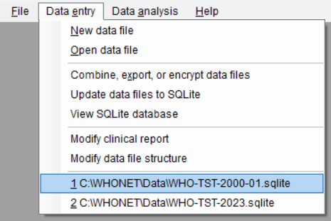
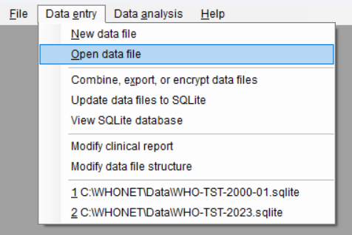
3
Open data file
If you see the name of the file that you would like to open, then click on it.
If you do not see the file, then select Open data file.
C

Slide 30
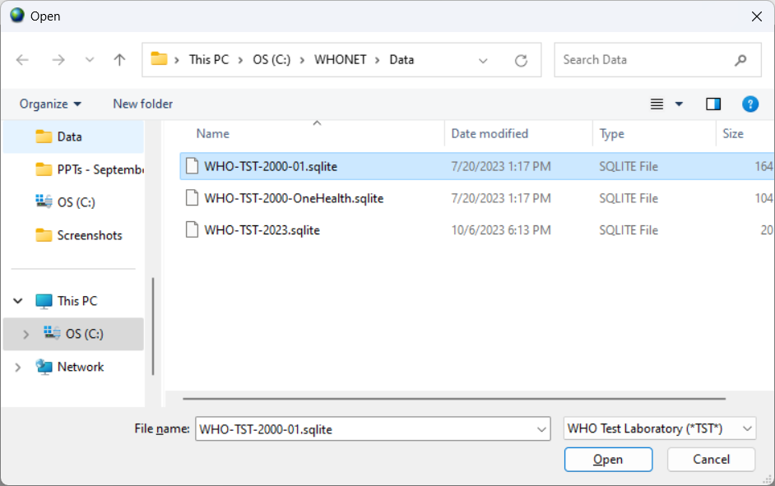
3
Module 3. Data entry -> Opening an existing data file
C

Slide 31
3
Module 3. Data entry -> Opening an existing data file
C

Slide 32
3
Module 3. Data entry
A
Create a new data file
B
Entering and editing data
C
Opening an existing data file
D
Clinical reports
E
Importing data with BacLink

Slide 33
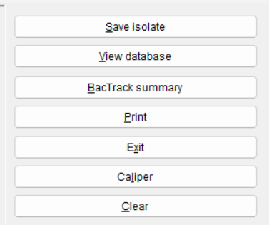
3
Printing results
D
Data entry
DD
View database

Slide 34
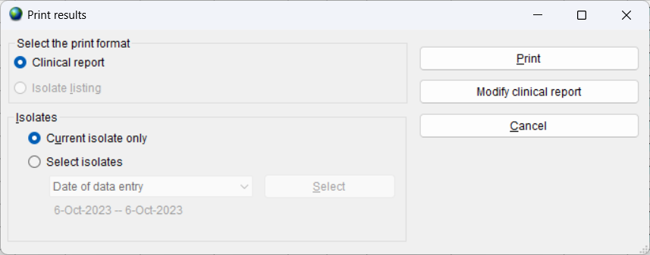
Clinical reports
3
You have the option to print out reports or to modify the content and formatting of the reports.
D

Slide 35
Printing the clinical report
3
D
You can send the report to a printer or to a PDF file. If you select PDF, Windows will ask you to give a name to the new PDF file.

Slide 36
Modifying the clinical report
3
You can use the below features to customize the content and formatting of the clinical reports.
D

Slide 37
Modifying the report header
3
D

Slide 38
3
Modifying the data fields
D

Slide 39
Modifying the report footer
3
D

Slide 40
3
Module 3. Data entry
A
Create a new data file
B
Entering and editing data
C
Opening an existing data file
D
Clinical reports
E
Importing data with BacLink

Slide 41
3
Module 3. Data entry -> Importing data with BacLink
E

Slide 42
2
Thank you for watching Module 3
Up next. Module 4: Introduction to data analysis

