Slide 1
BD EpiCenter™ WHONET Integration
Gurel SAHIN
EMA DMS & Instrument Expert
BD Diagnostics
gurel.sahin@bd.com
Jens Thomsen MD MPH
Chair, UAE Sub-Committee for AMR Surveillance
Abu Dhabi Public Health Center
Dept. of Health Abu Dhabi, UAE
jthomsen@doh.gov.ae

Slide 2
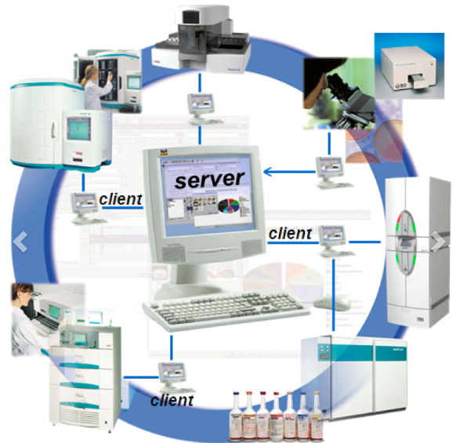
BD EpiCenterTM
Microbiology Data Management Software designed to
Improve the microbiology testing process
Enhance microbiology result quality
Conduct statistical / epidemiological analysis
Under regulations of CE-IVD (Europe) and FDA (USA)
BD EpiCenter Software can be directly interfaced to
BD BACTEC™
BD MGIT™
BD Phoenix™
BD Kiestra™
Bruker Biotyper™
and the HIS & LIS system
+ Manual microbiology tests

Slide 3
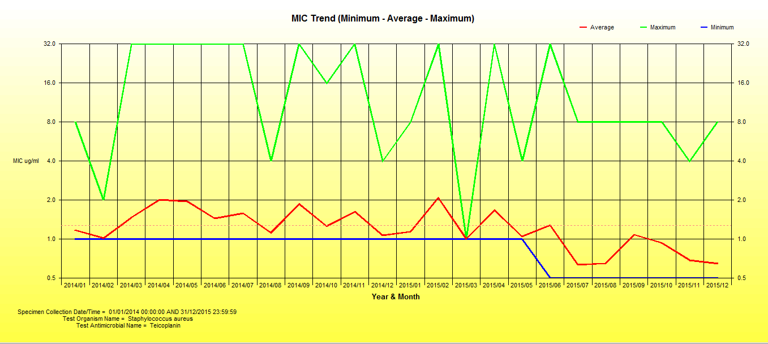
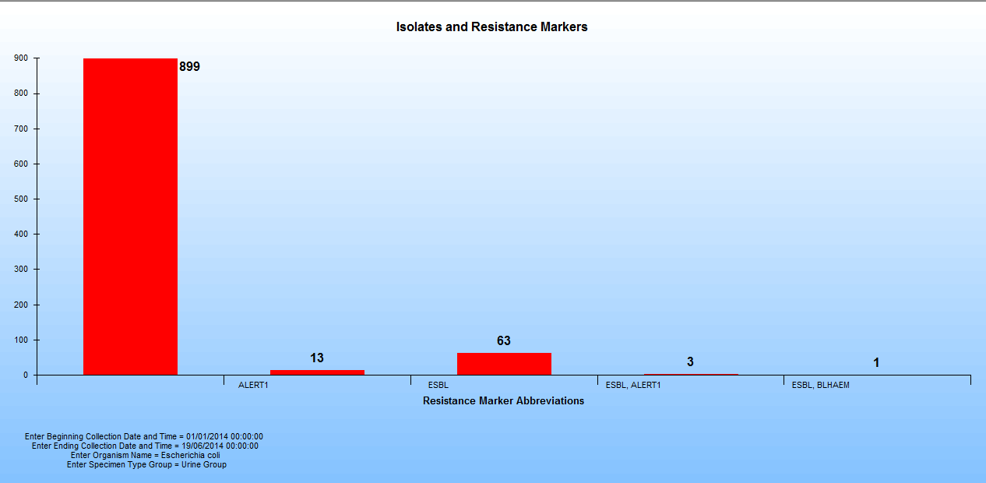
BD EpiCenterTM
Isolates and Resistance Markers
MIC Trend (Minimum – Average – Maximum)

Slide 4
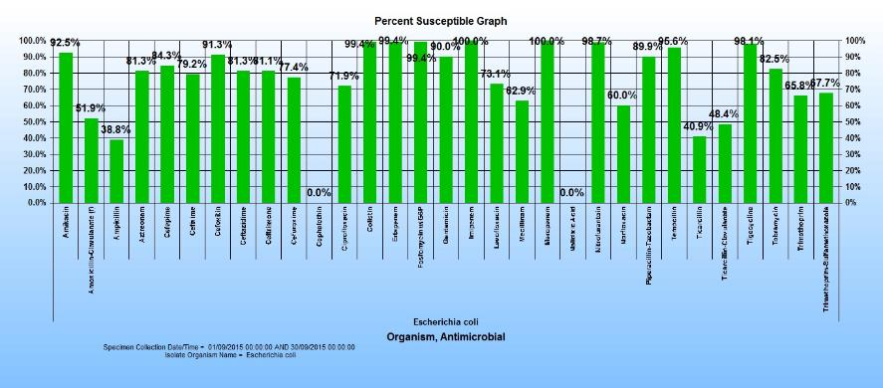
BD EpiCenterTM
Percent Susceptible Isolates (%S) Graph

Slide 5
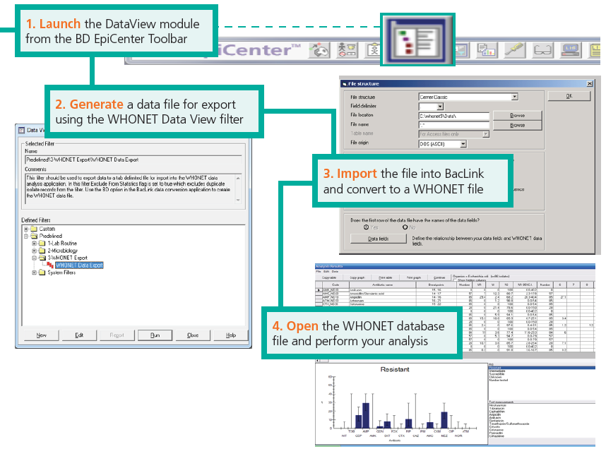
WHONET Data Export
Four easy steps to sharing a data file that can be read by BacLink, and uploaded to WHONET:
Launch Data View Module
Generate a data file
Convert the data file with BacLink
Open WHONET and perform your analysis
5

Slide 6
Step 1: Launch the DataView Module
Launch BD EpiCenterTM (V6.60 or above) and log in
Select the “Data View” reporting module from the toolbar:

Slide 7
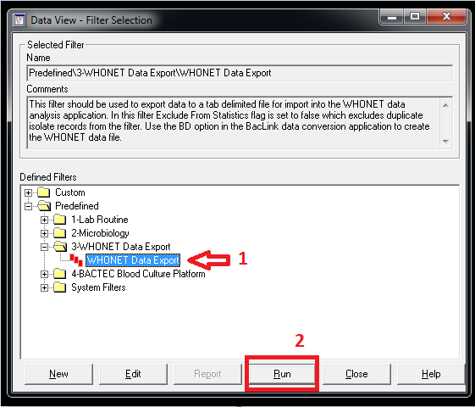
Step 2: Generate a Data File for Export
Select the predefined data filter in the following location:
Predefined
3-WHONET Data Export
3-WHONET Data Export
Press “Run”

Slide 8
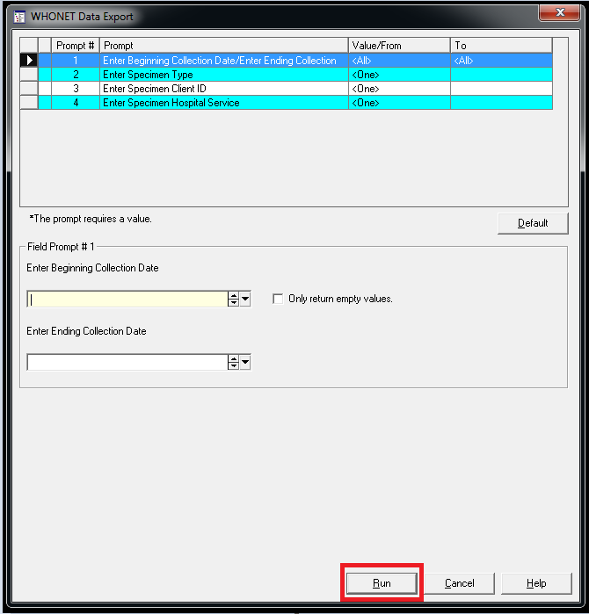
Step 2: Generate a Data File for Export
Enter the appropriate filter criteria to limit data returned:
Beginning Collection Date
Ending Collection Date
Press “Run”

Slide 9
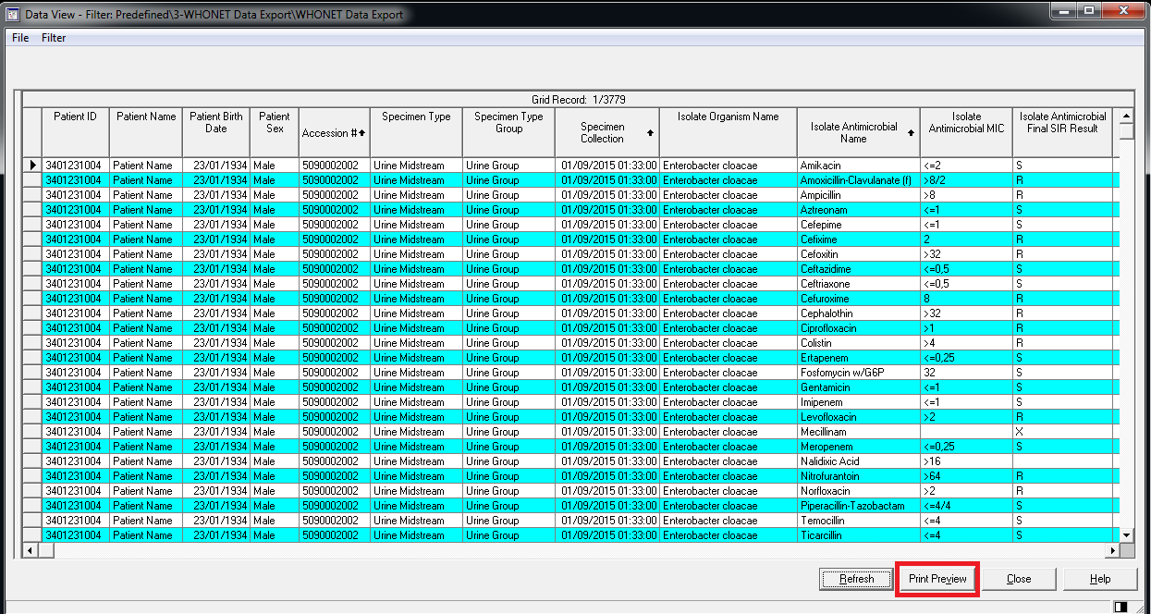
Step 2: Generate a Data File for Export
When the result data has been displayed:
Press “Print Preview”

Slide 10
Step 2: Generate a Data File for Export
When the print preview screen has appeared, press the
“Export” button
located on top and then select the option to export data to
“Tab separated text file”
File name and export file location will be suggested but could be modified before saving
Press “Save”

Slide 11
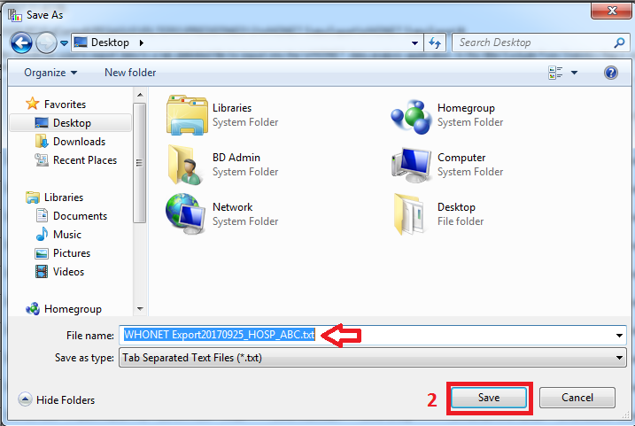
Step 2: Generate a Data File for Export

Slide 12
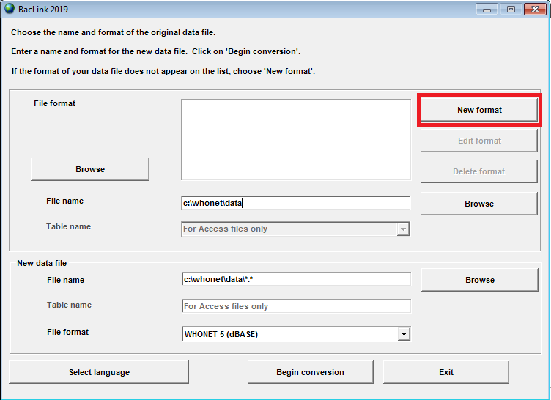
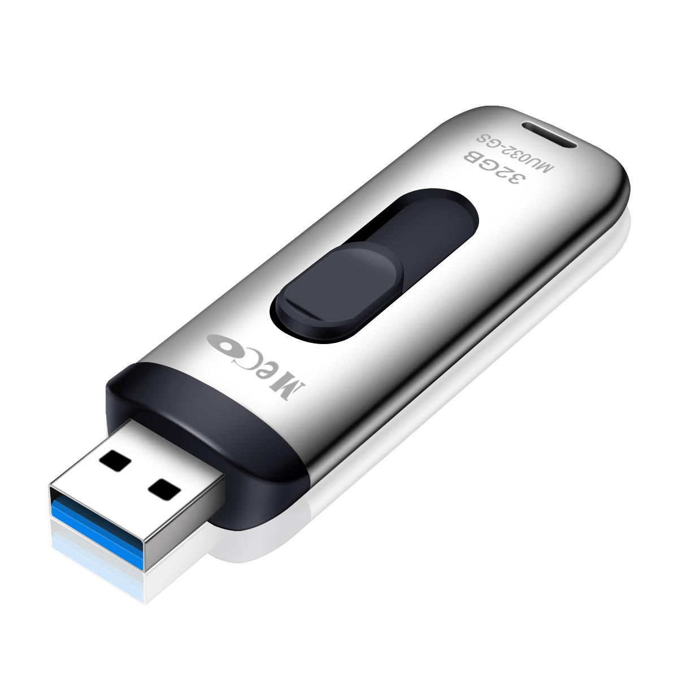
Step 3: Copy the Data File to the WHONET PC
Copy the data file onto a USB stick, then go to the WHONET computer, and save the data file into the folder:
C:\\WHONET\data
BD EpiCenter Computer
WHONET Computer

Slide 13
Step 3: Convert the File with BacLink
STEP 3A: Setting up the data conversion (one time only):
Open BacLink and press:
“New format”

Slide 14
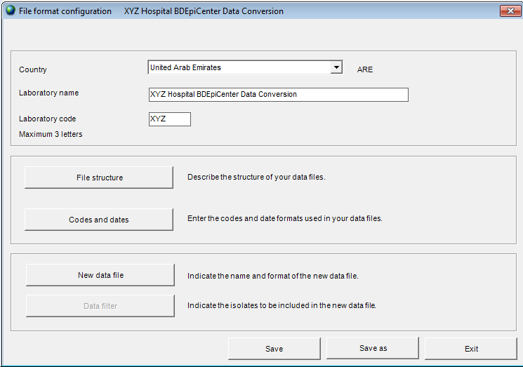
Step 3: Convert the File with BacLink
Enter basic information:
Country name
Lab name (full name)
Lab code (3 digits)
Press
“File structure”

Slide 15
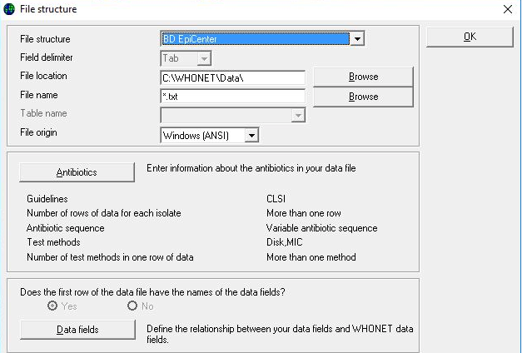
Step 3: Convert the File with BacLink
For File structure select
“BD EpiCenter”
Press
“OK”, and
“Save”

Slide 16
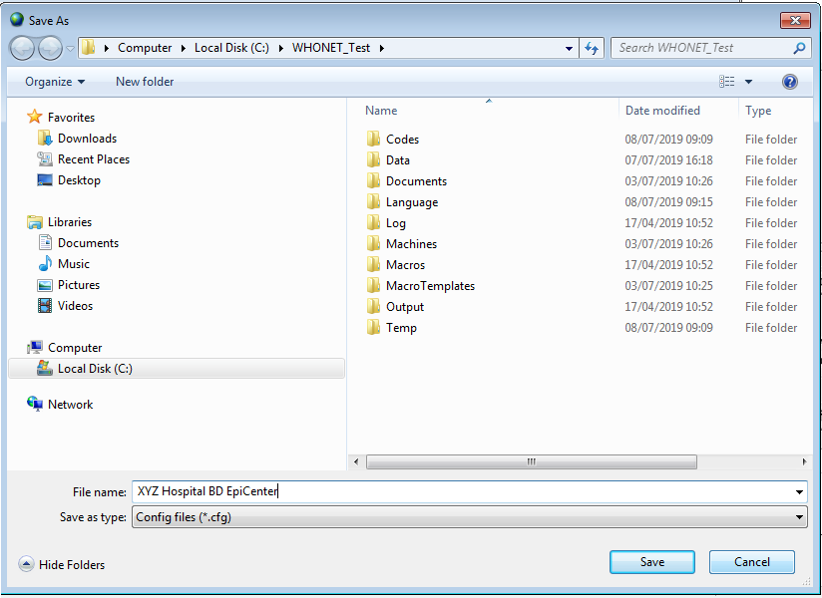
Step 3: Convert the File with BacLink
Select a file name, e.g.
“XYZ Hospital”
Press
“Save”, then press
“Exit”

Slide 17
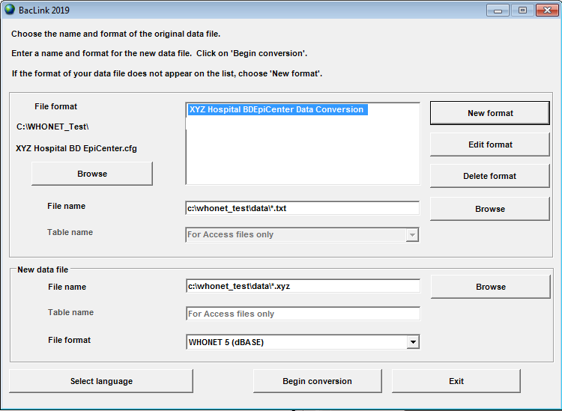
Step 3: Convert the File with BacLink
STEP 3B: Running the data conversion (repeat for each new data file):
For “File name”, select the BD EpiCenter data file
For “New data file” enter a file name, then press
“Begin conversion”

Slide 18
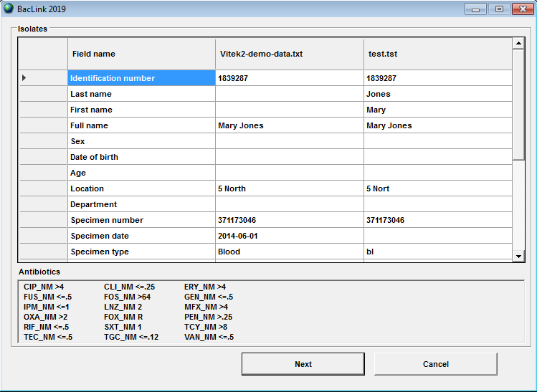
Step 3: Convert the File with BacLink
BacLink shows the first isolate
Check the quality of the data conversion, including
Length of fields
Date formats
If ok, press: “Next” (3 times)
Otherwise press “Cancel”, and “Edit format” to modify settings

Slide 19
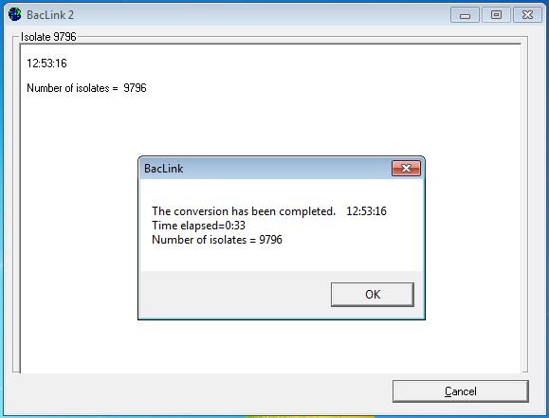
Step 3: Convert the File with BacLink
BacLink will run through the data file, converting all data to a WHONET database file
Check the number of isolates in the data file for plausibility, then click
“OK”

Slide 20
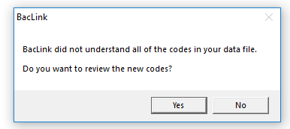
Step 3: Convert the File with BacLink
After the first conversion BACLINK might show a window, informing you that not all codes in the data file have been understood, and asking you if you want to review new codes.
For all data to be included in the WHONET file you should review the new codes, and as such click on “Yes”.

Slide 21
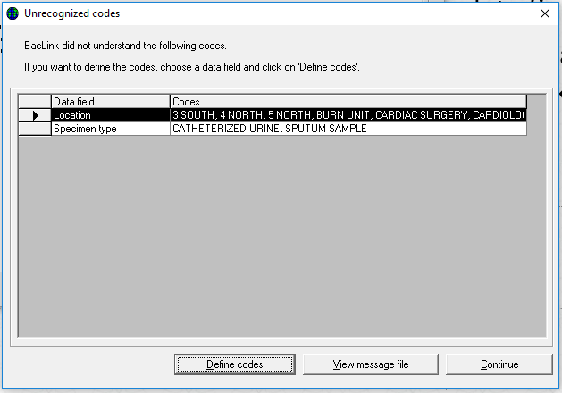
Step 3: Convert the File with BacLink
In the next window BacLink shows the data fields that have unrecognized codes (here ‘Location’ and ‘Specimen Type’)
Click on ‘Location’ and then on ‘Define codes’ to define the unrecognized location codes (3SOUTH, 4 NORTH, 5NORTH, etc.)
Do the same for ‘Specimen type’
After defining all unrecognized codes, click on ‘Continue’ and ‘Begin conversion’ to run the conversion again

Slide 22
Step 3: Convert the File with BacLink
Once all codes are defined press
“OK”, and
“Exit”

Slide 23
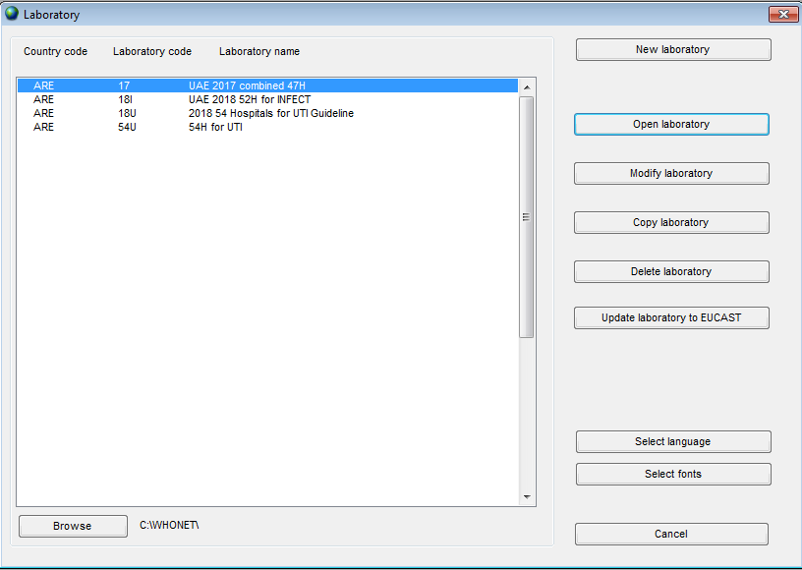
Step 4: Open the File with WHONET
Start WHONET and press “Cancel”

Slide 24
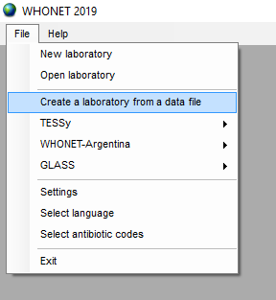
Step 4: Open the File with WHONET
Click on
“File” and then
“Create a laboratory from a data file”

Slide 25
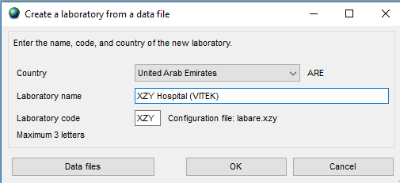
Step 4: Open the File with WHONET
Enter “United Arab Emirates” for country, or as applicable
Enter Laboratory name and three digit code
Click on “Data files” and select the newly created WHONET file
Click on “OK”
1.
2.
3.

Slide 26
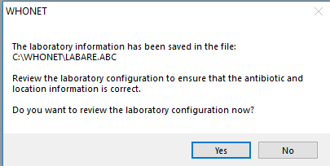
Step 4: Open the File with WHONET
In the following screen click on “Yes” to review the laboratory configuration (this is optional)

Slide 27
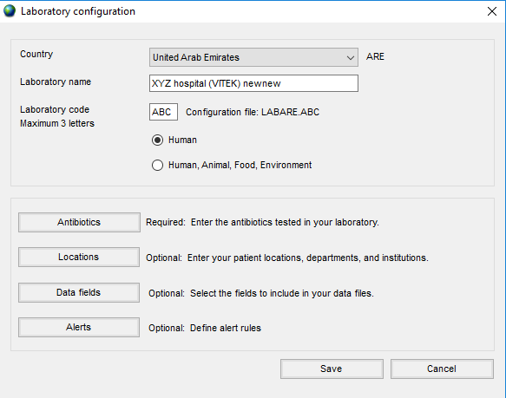
Step 4: Open the File with WHONET
In the “Laboratory configuration screen” you can review the laboratory configuration, including antibiotics, locations, data fields, and alerts, and modify them if needed.
Click on “Save” to save the newly created lab configuration.

Slide 28
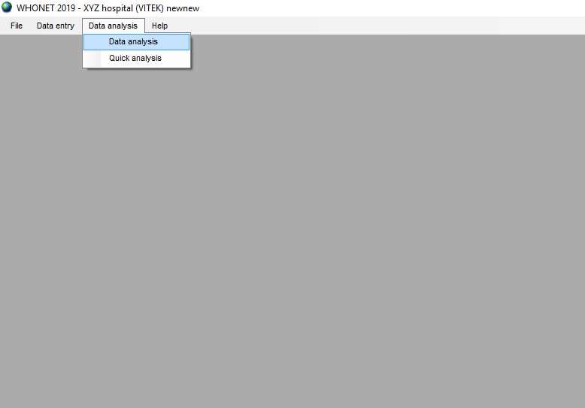
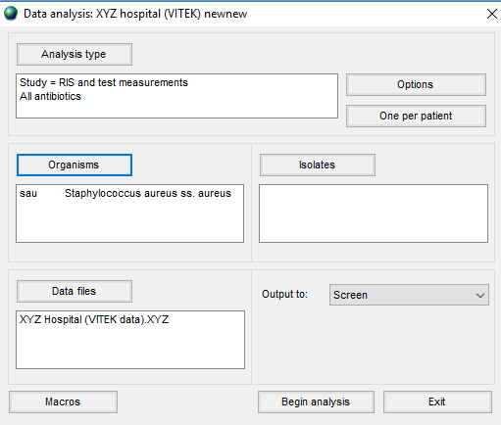
Step 4: Run the analysis with WHONET
The WHONET file is now ready for analysis.
To perform an analysis on this file click on “Data analysis” and “Data analysis” again
Then click on
“Analysis type” to select the analysis type (e.g. “%RIS and test measurements”, and
“Data files” to select the new file
“Organisms” to select the organism (e.g. Staph. aureus), then click on
“Begin analysis”

Slide 29
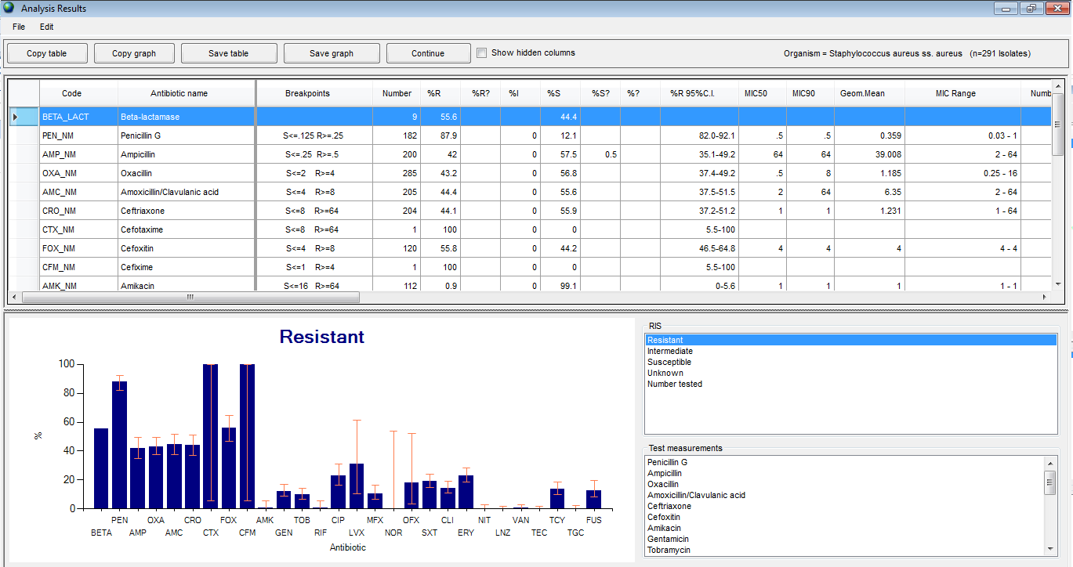
Step 4: Run the analysis with WHONET
The analysis results screen should show something similar to this:
Review analysis results, then click on
“Continue” to proceed

Slide 30
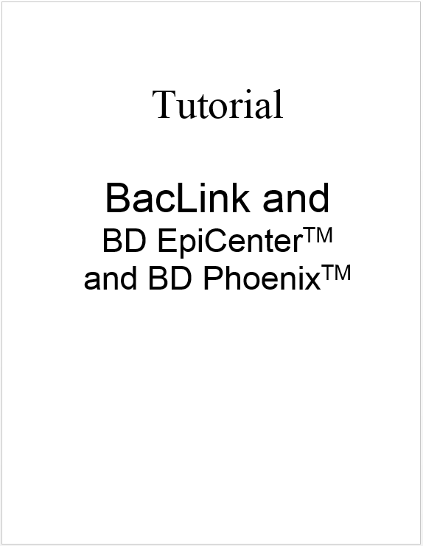
Reference and further reading
For further details please refer to WHONET tutorial “BacLink 8.AST Vitek 2.English”
This tutorial can be found online at:
www.whonet.org (→ documents)
The file can also be found locally on the C: drive of your PC in the folder:
C:\\WHONET\documents

