Slide 1
baclink data import module
WHO Collaborating centre for surveillance of antimicrobial resistance
Data export: Exporting data from phoenix

Slide 2
BacLink Tutorial – Exporting data from Microscan LabPro
The instructions are divided into four parts:
1. Downloading and installing WHONET and BacLink
2. Exporting data from Microscan LabPro
3. Converting data with BacLink
4. What’s the next steps?
The purpose of this document is to guide users of the Microscan LabPro identification ana susceptibility test instrument through the export of data to WHONET.
The frequency of data conversions depends on the local data analysis needs and interests. Many laboratories find that a weekly or monthly download is adequate for their infection control and quality assurance purposes, while less frequent analysis may be adequate if the principal use of the data is in following trends in resistance and guiding treatment recommendations. Automated daily downloads of data from Microscan LabPro into WHONET is also a possibility, and is described below.

Slide 3
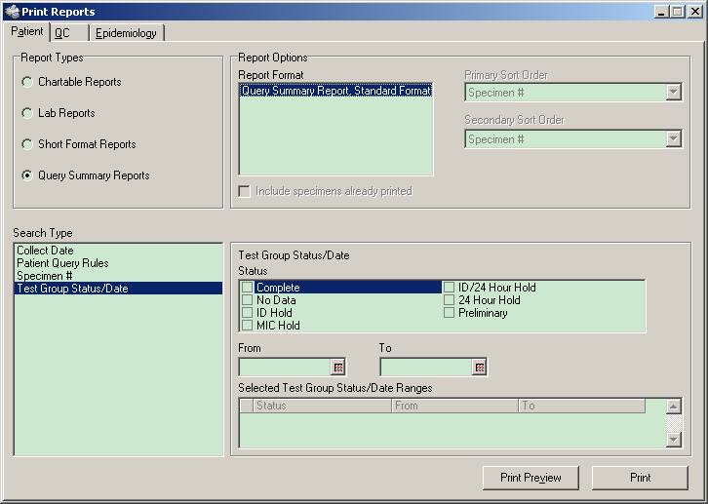
PART 2.1 EXPORTING DATA FROM Microscan Labpro
Open Microscan and click on Reports.

Slide 4
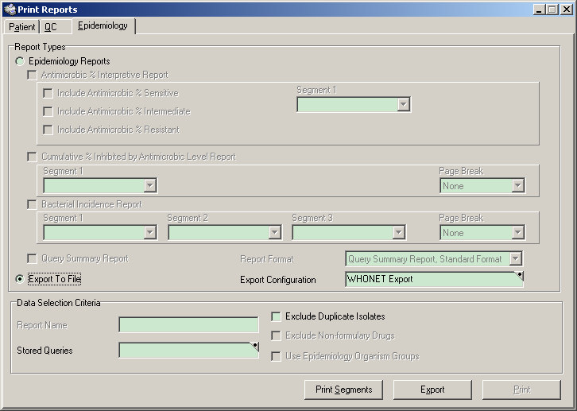
PART 2.2 EXPORTING DATA FROM microscan labpro
Click on the “Epidemiology” tab on the top right.
Click on the “Export to File”
Click on the small dot/triangle in the top right section of the “Export Configuration Tab”

Slide 5
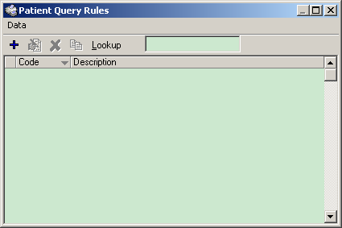
PART 2.3 EXPORTING DATA FROM microscan labpro
On the Top of the screen click on the Code field. Call it “WHONET E” Click on the Description Field Call it “WHONET Export”
Click on Specimen Data Click on “Add” in the middle of the screen. This should move all of the criteria over to the “Selected Data” column. Click on Patient Data Click on “Add” in the middle of the screen. This should move all of the criteria over to the “Selected Data” column.
Click on Isolate Data. Click on “Add” in the middle of the screen. This should move all of the criteria over to the “Selected Data” column.

Slide 6
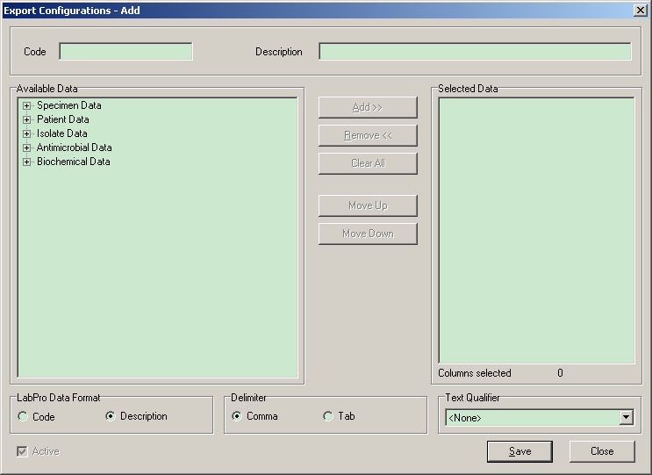
PART 2.4 EXPORTING DATA FROM microscan labpro
On the Top of the screen click on the Code field. Call it “WHONET E” Click on the Description Field Call it “WHONET Export”
Click on Specimen Data Click on “Add” in the middle of the screen. This should move all of the criteria over to the “Selected Data” column. Click on Patient Data Click on “Add” in the middle of the screen. This should move all of the criteria over to the “Selected Data” column. Click on Isolate Data. Click on “Add” in the middle of the screen. This should move all of the criteria over to the “Selected Data” column.
Click on Antimicrobial Data Click on MIC/Interpretation Click on “Add” in the middle of the screen. This should move all of the criteria over to the “Selected Data” column.

Slide 7
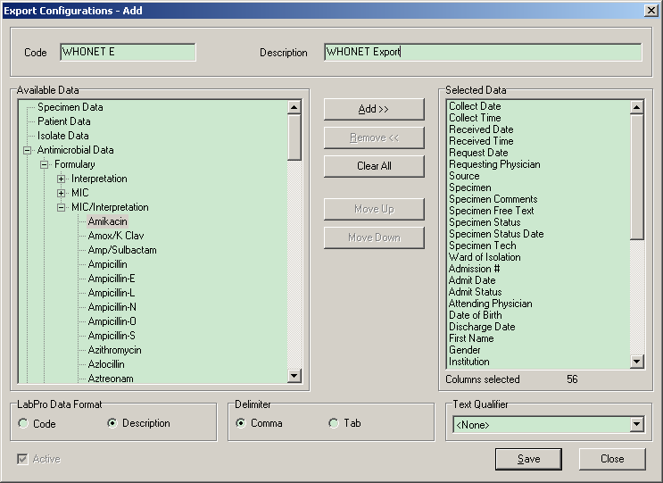
PART 2.5 EXPORTING DATA FROM microscan labpro
On the selected data column remove the following fields (Click the field, then click remove in the middle of the screen)
Patient Comments 1 Patient Comments 2 Patient Comments 3 Patient Comments 4 Patient Comments 5
Patient Free Text
On the selected data column remove the following fields (Click the field, then click remove in the middle of the screen) Isolate Comments 1 Isolate Comments 2 Isolate Comments 3 Isolate Comments 4 Isolate Comments 5
Isolate Free Text
Click on “Save”
On the selected data column remove the following fields (Click the field, then click remove in the middle of the screen)
Specimen Comments 1 Specimen Comments 2 Specimen Comments 3 Specimen Comments 4 Specimen Comments 5
Specimen Free Text

Slide 8
PART 2.6 EXPORTING DATA FROM microscan labpro
Click on “Save” and Go back to the main Epidemiology screen.

Slide 9
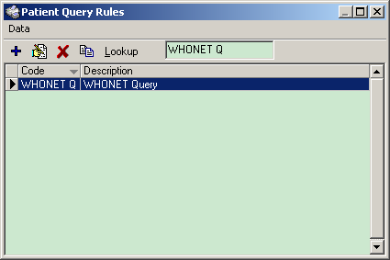
PART 2.7 EXPORTING DATA FROM microscan labpro
Click on the small dot/triangle in the top right section of the “Stored Queries Tab”
Click on the + sign to create a new Query

Slide 10
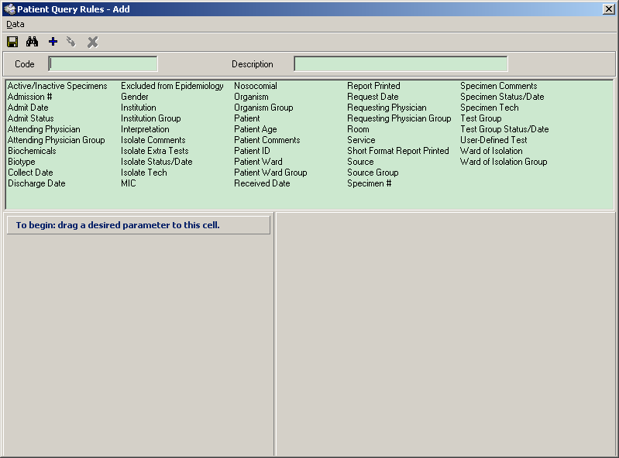
PART 2.8 EXPORTING DATA FROM microscan labpro
Click on the Code Tab and call it WHONET Q
Click on the Description Tab and call it WHONET Query
Click on “Collect Date” and drag it down to the column below it.

Slide 11
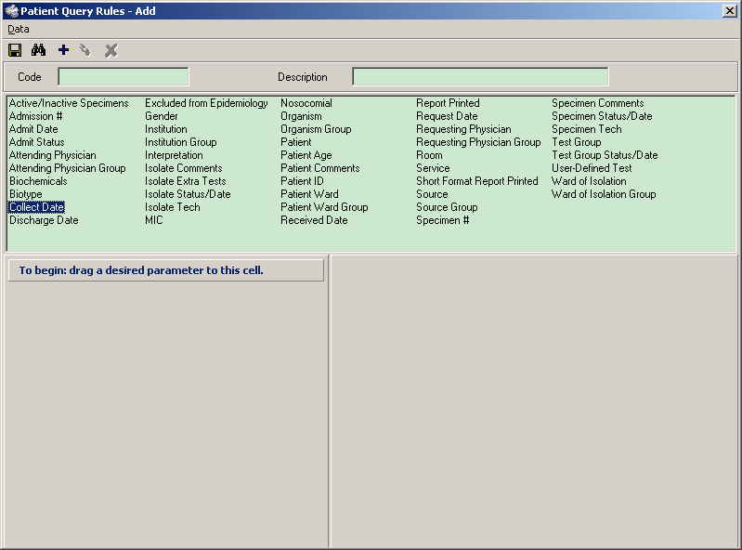
PART 2.9 EXPORTING DATA FROM microscan labpro
Click on the Code Tab and call it WHONET Q
Click on the Description Tab and call it WHONET Query
Click on “Collect Date” and drag it down to the column below it.

Slide 12
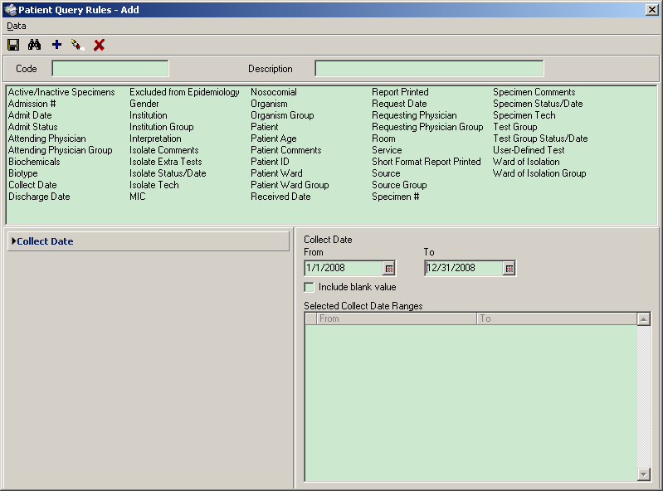
PART 2.10 EXPORTING DATA FROM microscan labpro
On the right hand side change the dates to whatever dates you would like.

Slide 13
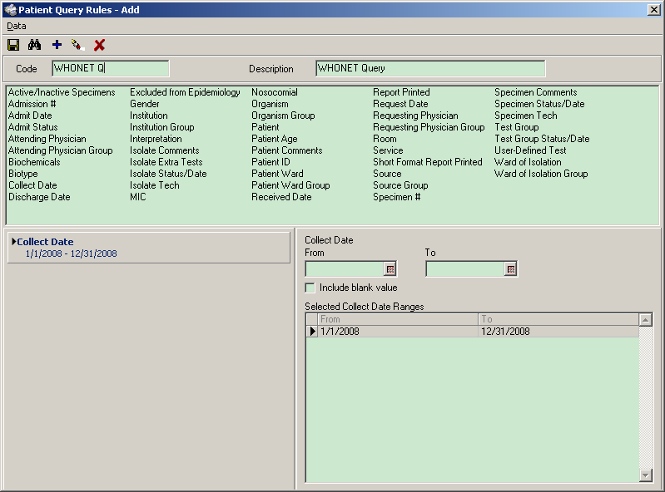
PART 2.11 EXPORTING DATA FROM microscan labpro
On the top left of the screen click on the icon shaped like a floppy disk, the first one on the left right below the word “Data” to save this query.

Slide 14
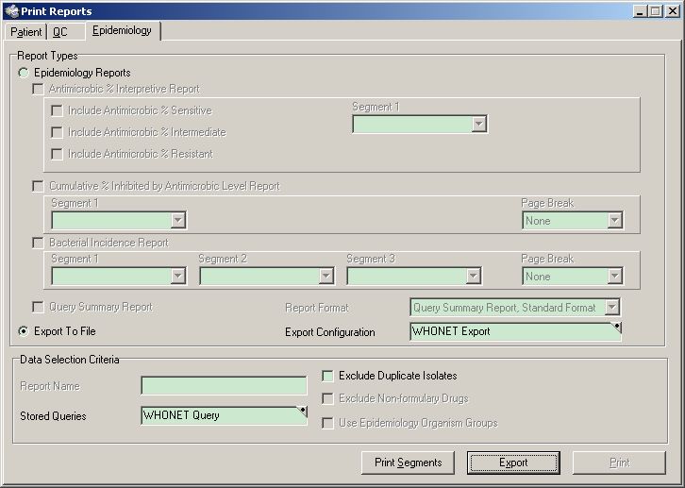
PART 2.12 EXPORTING DATA FROM microscan labpro
Go Back to the main Epidemiology screen
Click on “Export”
Save the file.

Slide 15
Thank you!
On behalf of the WHONET Team, thank you for learning about the WHONET & BacLink Software!

